Slide 1
Financial Market Analysis Leveraging PySpark
PRESENTED BY:
Sai Teja Bandaru
Pranav Gokavarapu

Slide 2
INTRODUCTION
In today's dynamic financial landscape, the ability to analyze vast amounts of market data in real-time is essential for making informed investment decisions and staying ahead of the curve. Traditional analytical methods struggle to keep pace with the volume and velocity of financial data, necessitating the adoption of distributed computing frameworks like MapReduce and PySpark.
Evolution of Financial Markets: Increasing complexity and volume of financial data demand efficient analysis tools.
Distributed Computing Paradigm: PySpark offer scalable and fault-tolerant frameworks for parallel processing.
PySpark in Action: This frameworks enable complex analytics tasks and swift decision-making in financial analysis.

Slide 3
MODEL ARCHITECTURE FLOW
Data Collection
Data Processing
Model Analysis using LSTM
Building Predictive Classification Model
Data Visualization using Microsoft Power BI

Slide 4
DATA COLLECTION
Obtain a list of NASDAQ-traded symbols from a CSV file provided by NASDAQ.
Filter out non-trading symbols to ensure data integrity.
Address cases where data for certain symbols may not be available or cannot be downloaded.
Create separate directories for stocks and ETFs to categorize and store downloaded data.
Generate metadata containing information about valid symbols and their characteristics, such as ETF status.
Prepare the collected data for subsequent analysis and insights generation.
Ensure that the collected data is structured and ready for further processing, visualization, and interpretation.

Slide 5
DATA PROCESSING
Extract the ticker symbol from the file path and add it as a new column.
Perform data cleaning operations such as handling missing values and ensuring data consistency.
Analyze descriptive statistics such as count, mean, min, max, etc., to gain insights into the dataset.
Create new features from existing data that might be useful for analysis and modeling.
Manipulate date columns to extract relevant time-based features like year, month, week, etc.

Slide 6
DATA PROCESSING (CONTD.)
Group the data based on various criteria such as ticker symbol, year, month, or week.
Aggregate data within each group to calculate summary statistics or derive new insights.
Merge datasets based on common columns or keys.
Export the processed and transformed data to a suitable format for further analysis and modeling.
Write the final DataFrame to a CSV file, optionally performing additional operations like partitioning or sampling.

Slide 7
Long Short Term Memory(LSTM) Network for Stock Price Prediction
LSTM is a Recurrent Neural Network that works on data sequences, learning to retain only relevant information from a time window.
New information the network learns is added to a “memory” that gets updated with each timestep based on how significant the new sample seems to the model.
Scale the features using MinMaxScaler to bring them within a similar range.
Split the data into training and testing sets using TimeSeriesSplit.
Reshape the input data into a 3D array as required by the LSTM model.

Slide 8
MODEL ANALYSIS- LSTM (CONTD.)
Compile the model using the Adam optimizer and mean squared error loss function.
Fit the LSTM model to the training data.
Specify the number of epochs and batch size for training.
Predict the stock prices using the trained LSTM model.
Calculate the Root Mean Squared Error (RMSE) between the predicted and true values.
Plot the true values against the LSTM predicted values to visualize the model performance.

Slide 9
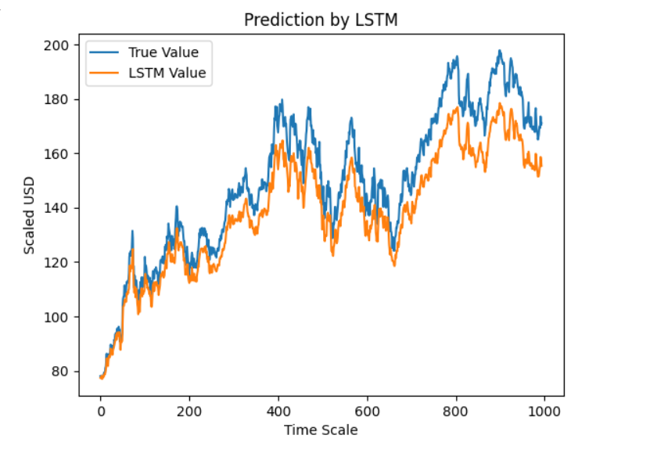
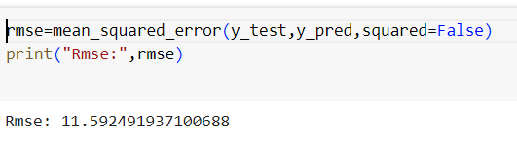
MODEL ANALYSIS- LSTM (CONTD.)

Slide 10
MODEL ANALYSIS- CLASSIFICATION (CONTD.)
The data is loaded from a CSV file into a Spark DataFrame.
Ticker column is converted to a unique identifier code (TickerId).
Date is split into Year, Month, and Day columns and converted to integers.
'Close' and 'Adj Close' columns are dropped from the DataFrame.
A new column 'Balance' is created, representing the difference between 'Adj Close' and 'Open' prices.
Another column 'In_or_de' is created(target), marking positive balance as 1 and negative balance as 0.
- Imputation for missing values and encoding categorical variables is performed.
- Features are assembled into a vector.
- Standard scaling and PCA (Principal Component Analysis) are applied for feature scaling and dimensionality reduction, respectively.

Slide 11
MODEL ANALYSIS- CLASSIFICATION (CONTD.)
- A subset of the data (30,000 rows) is taken for model training and testing.
- The subset is split into training and testing sets (80% train, 20% test).
- Random Forest classifier is defined with hyperparameters like number of trees and max depth.
- Pipeline is constructed, including data preprocessing and model building.
- Cross-validation is performed to tune hyperparameters.
- The best model is evaluated on the test set, and F1 score is calculated.
- Similar steps are followed as in Random Forest, but with different hyperparameters and algorithm.
- The best model from the subset analysis is chosen.
- The entire dataset is split into training and testing sets.
- The chosen model is fitted on the training data and evaluated on the test set.
- F1 score is used as the evaluation metric due to class imbalance.

Slide 12
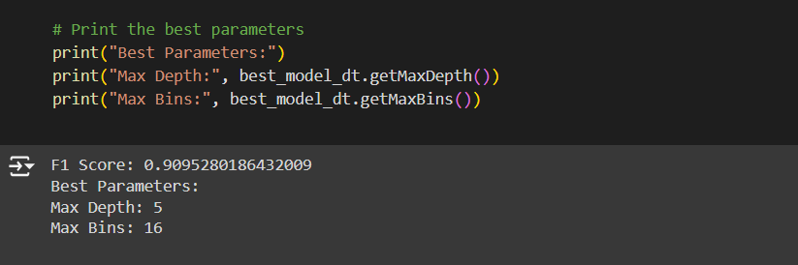
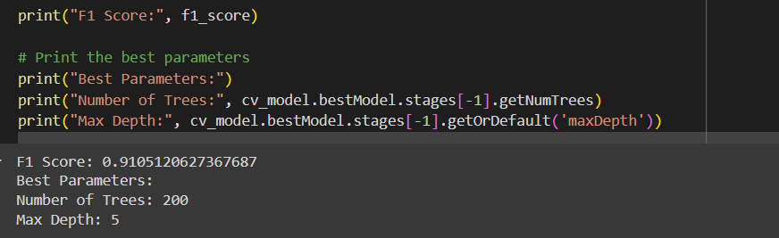
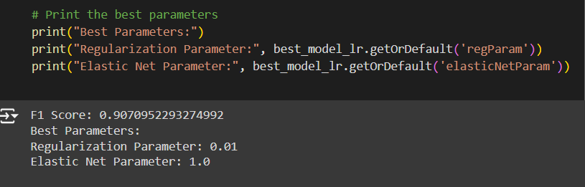
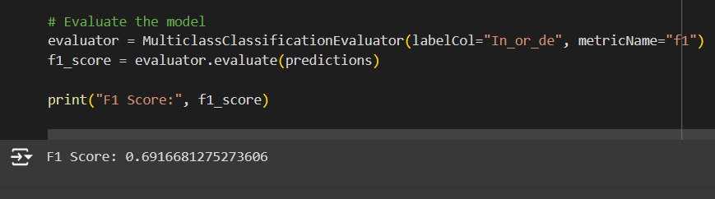
MODEL ANALYSIS- CLASSIFICATION (CONTD.)

Slide 13
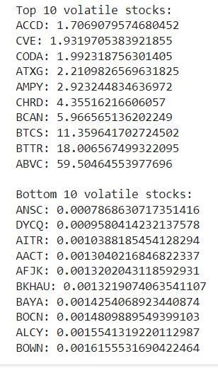
MODEL ANALYSIS- VOLATILITY
Stock volatility is the degree to which stock prices and market indexes change over time. Stocks with dramatic price swings, such as new highs and lows, are considered highly volatile. A stock with a relatively stable price has low volatility.
Calculate Volatility: Calculates the volatility of a stock based on its returns.
The code iterates over CSV files in a specified directory containing stock data.
For each CSV file, it calculates the volatility based on the adjusted close prices.
The top 10 and bottom 10 volatile stocks are identified.
The results are written to a CSV file.

Slide 14
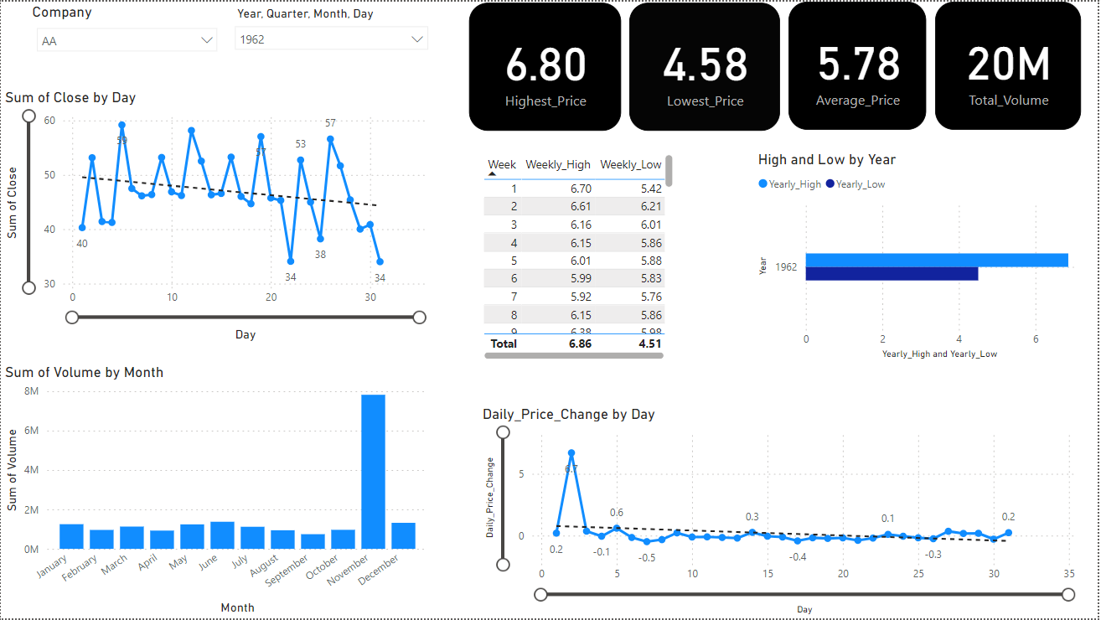
DATA VISUALISATION

Slide 15
OUTCOMES ACHIEVED
Efficient Data Processing: Rapid analysis of large-scale financial datasets for market trends and anomalies.
Enhanced Decision-Making: Deeper insights into market dynamics, enabling data-driven investment decisions.
Scalable Analytics: Seamless scalability to handle increasing volumes of financial data with ease.
Real-Time Insights: Swift identification of trading opportunities and risks in dynamic financial markets.
Competitive Advantage: Leveraging advanced analytics to gain a competitive edge in financial trading and investment.

Slide 16
THANK YOU

